Slide 1

Implementation of the revised
RTTI Delegated Regulation
Online workshop NAPCORE
February 1st 2023

Slide 2
Welcome
Timo Hoffmann (BAST, DE)
NAPCORE General Secretary
Special thanks to some members of the NAPCORE Advisory Board:
  TomTom, TM2.0, Tisa, POLIS, CEDR and Google

Slide 3

What is this online workshop about?
Brief overview of the revised RTTI DR and how NAPCORE wants to facilitate in the implementation
(Annet van Veenendaal, NDW, NL)
Several Road Authorities will present their thoughts on use cases to work on (including discussion)
What do these use cases mean for the way public-private collaboration between Road Authorities and Private Serviceproviders?
(Johanna Tzanidaki, Chair, TM 2.0 Innovation Platform)
Private Serviceproviders perspective
(Stephanie Leonard, TomTom)
Wrap up, follow up
(Annet van Veenendaal, NDW, NL)
Closing
(Timo Hoffmann, General Secretary NAPCORE)

Slide 4
Overview
Delegated Regulation (EU) 2022/670: Provision of EU-wide real-time traffic information services
Substitutes Delegated Regulation (EU) 2015/962
Goal
Improving the accessibility, exchange, re-use and update of data required for the provision of high quality and continuous real-time traffic information services across the Union.

Slide 5
What’s new? -> Data types
Data types
In addition to known data types, the focus is now very much on (the crucial data categories):
  Traffic regulations and restrictions
    Traffic laws (e.g. speed limits, access restrictions)
    Regulated traffic zones (e.g. environmental, freight delivery)
    Traffic circulation plans
  State of the network
    Road- and lane closures
    Roadworks
    Temporary traffic management measures.
The standards DATEX II or TN-ITS are required (in addition to INSPIRE for network data.)

Slide 6
What ‘s new -> Data types
Del Reg. 2022/670
data on infrastructure
data on regulations and restrictions
data on the state of the network
data on the real-time use of the network
(a) road network links
(b) road classification
(c) tolling stations
(d) service areas and rest areas;
(e) recharging points for electric vehicles
(f) compressed natural gas, liquefied natural gas, liquefied petroleum gas stations
(g) points and stations for all other fuel types
(h) location of delivery areas
Crucial:
(a) static and dynamic traffic regulations
(b) traffic circulation plans
Non-crucial:
(a) traffic signs
(b) static and dynamic traffic regulations
(c9 tolled roads,
(d) variable road user charges
Crucial:
(a) road closures;
(b) lane closures;
(c) roadworks;
(d) temporary traffic management measures.
Non-crucial:
(a) bridge closures;
(b) accidents and incidents;
(c) poor road conditions;
(d) weather conditions affecting road surface and visibility.
(a) traffic volume;
(b) traffic speed;
© traffic queues;
(d) travel times;
(e) waiting time at border crossings;
(f) delivery areas;
(g) recharging points and stations for electric vehicles;
(h) refuelling points and stations for alternative fuel types;
(i) price of ad hoc recharging/refuelling.
Green = new

Slide 7
What’s new? -> Geographical scope
Extension of geographical scope
The scope of 2015/962 was the TEN-T network. In 2022/670 the geographical scope is extended tot the entire network in the following phases:
1 January 2023 – providing a list and map visualisation of roads included in the ‘primary road network’*
1 January 2025 – providing all crucial data categories for the entire network, other data for primary road network
1 January 2025 – 1 January 2027 – providing all data categories for the entire network
  * to be defined by each Member State

Slide 8
Reading between the lines…
Analysis of the revised RTTI DR

Slide 9
Analysis
“These specifications should not oblige any stakeholder to start collecting any data that they are not already collecting or to digitize any data that is not already available in a digital machine-readable format.".
  No obligation to collect or digitize data, but data transformations & enrichments may be necessary to meet format requirements!

Slide 10
Analysis
“…minimum quality requirements that Member States shall agree upon in cooperation with relevant stakeholders.”
  Quality Framework to be elaborated together with serviceproviders!
“…correct any inaccuracies detected … or signaled to them by any data users and end-users.”
  Improving quality through validation, also including feedback from users (feedbackloop)!

Slide 11
Analysis
“…update… within a timeframe fitting to the reliable and effective use of the data…”
  Need for low latencies for provision/updating!
  Agreement with serviceproviders on ‘timeliness’!
“…road authorities and road operators may request holders of in-vehicle generated data…”
  Grants road authorities access to vehicle-generated data for defined purposes – not free of charge, but "FRAND” (Agreement with serviceproviders on clear definitions on Fair, Reasonable and Non-Discriminatory) !

Slide 12
Analysis
“Data …that has been archived by road authorities or road operators…”
“…predictive data on the state of the network that has been computed by road authorities or road operators…”
“…, shall be made accessible for exchange and re-use…”
  Need for historical data!
  Need for predictive data (pro-active traffic management)!

Slide 13
Analysis
“To improve the benefits for road users in terms of road safety and less congestion, these (RTTI) services should also reflect the priorities of road authorities, as expressed f.e. through digitally accessible traffic circulation plans.”
“Serviceproviders shall process and include, without additional costs to the end user, in the relevant services they provide, any temporary traffic management measures developed by the competent road authorities and made accessible via the national or common access point …
  Need for agreement on what is meant by “traffic circulation plans” and “traffic management measures”!

Slide 14
Conclusions
Substantial obligations for public authorities to provide data, some of them already as of January 2025.
Many of these requirements require a coordinated public-private approach.
NAPCORE wants to facilitate in this by bringing road authorities and private serviceproviders together.
In this we want to focus on USE CASES rather than the data itself. So Road Authorities please let us know your wishes on this!

Slide 15
Received input on use cases

Slide 16
Road Authority Navigation Challenge
What problem/challenge do you think is caused by navigation/routing services in your road network? Which sources can validate this claim?
Why does this problem/challenge occur in your opinion?
What is the consequence of this problem/challenge in your road network?
What possible mitigation measures could address this problem/challenge?
Do you see the same challenge/problem?
Please do a thumbs up or give digital applaus so we can monitor how many Road Authorities find this interesting use cases!
Level of Priority: High / Medium / Low

Slide 17
City of Groningen (NL)
Navigation Challenge No. 1
What problem/challenge do you think is caused by navigation/routing services in your road network? Which sources can validate this claim?
Routing and re-routing of traffic over roads that are not designated for this in terms of policy (e.g. based on a multimodal network framework)
Why does this problem/challenge occur in your opinion?
The policy information is not available digitally in a uniform format
What is the consequence of this problem/challenge in your road network?
Policy and practice do not correspond and static signage and digital route information sometimes contradict each other
What possible mitigation measures could address this problem/challenge?
Standardizing the information exchange (digitizing policy information) is step 1. This is followed by the use of this information by SPVs in their route advice.
Level of Priority: High

Slide 18
City of Helmond Navigation Challenge No. 1
What problem/challenge do you think is caused by navigation/routing services in your road network? Which sources can validate this claim?
Mostly the fastest/shortest routes are advised, not necessarily the preferred routes based on livability or road safety. Or the way we think the roads should be used. And therefore we see in our data (traffic light controllers and other road side stations) that less important roads are as busy as more important roads. Of course the lay-out of the network and the traveltimes for the different routes do not always match with our preferred usage.
In Helmond we mainly see this on the south-west, south-north(and vice versa) movement in the city where less important routes are preferred by users.
Other “problem” could be on the side of emergency services, maybe we can lead traffic away from accidents or routes used by emergency services. No sources available for this one, except expert judgement.
Why does this problem/challenge occur in your opinion?
It’s a combination of several items: Our city grows and expands and that doesn’t mean that it was well designed with these challenges in mind. Changing them afterwards requires time, money and political support;
The difference in traveltimes / availability of the preferred route by the city and the preferred route from the user or service provider are too big;
Local knowledge of the user of the network and their experiences over the past.
We will not claim that service providers are the problem, the combination of their algorithms, their unawareness of the preferred network/routes and the items mentioned above causes the problem.
What is the consequence of this problem/challenge in your road network?
Roads that are meant for ‘destination traffic’ are used for cut-through traffic and that gives some problems for accessibility, livability and (road) safety. It occurs for cars as for trucks (for example: Kanaaldijk and Eikendreef).
And also that roads are being used by traffic that maybe shouldn’t be there.
What possible mitigation measures could address this problem/challenge?
First of all, cities are responsible for providing a proper lay-out. But if we can inform service providers about how we want to use the network and why ((road) safety, livability) it helps in achieving the goal. And of course why users get offered an alternative, how can we communicate it to them.
Level of Priority : Medium

Slide 19
City of Stuttgart Navigation Challenge No. 1
What problem/challenge do you think is caused by navigation/routing services in your road network? Which sources can validate this claim?
So far the navigation/routing services don’t follow our traffic-management-strategies and recommendations. This is caused as users trust the routing services more than government-provided strategies
Through our analysis of the traffic-flow, we can see, that recommendations are being ignored
Why does this problem/challenge occur in your opinion?
So far no legal requirement
Multiplied by bad experience
Drivers are not aware of government-provides strategies
Service-Providers are not aware of government-provided strategies
What is the consequence of this problem/challenge in your road network?
recommended diversions and recommendations are not used, more traffic jams
there are higher emissions and more safety-critical situations in the traffic
What possible mitigation measures could address this problem/challenge?
Consistant traffic recommendation will be followed from the drivers. Especially if they can be sure, that there is a benefit.
The service-providers can see a benefit by following the government-provided strategies.
publish that the information come from the governance and are forwarded to the services.
Consistent, quick and easy Data transmission to routing services
Level of Priority: High

Slide 20
City of Ghent Navigation Challenge No. 1
What problem/challenge do you think is caused by navigation/routing services in your road network? Which sources can validate this claim?
Route guiding without destination through neighbourhoods and streets not designed for large volumes of traffic.
The route guiding itself + ANPR cameras
Why does this problem/challenge occur in your opinion?
Navigation services do not take the road network (enough) into account, and offer the quickest route regardless the type of road (schools,…).
Cities are taking circulation plans to stop this kind of drive-through traffic, but this is a slow process.
What is the consequence of this problem/challenge in your road network?
Traffic is sent through streets which are not designed for big traffic volumes.
What possible mitigation measures could address this problem/challenge?
As a city we should be able to have influence on the route guiding process.
Level of Priority: High

Slide 21
City of Ghent Navigation Challenge No. II
What problem/challenge do you think is caused by navigation/routing services in your road network? Which sources can validate this claim?
Difficult to make adaptations (e.g. name or circulation change) and corrections (e.g. street temporary closed). There is not a simple way to pass information to all service providers. We do not have priority accounts to make corrections.
Why does this problem/challenge occur in your opinion?
A standard platform to share map data for authorities does not exist.
All service providers should provide authorities an easy way to report errors (not the same platform as citizens).
What is the consequence of this problem/challenge in your road network?
We receive a lot of complaints from citizens, and have to put a lot of manual effort in adjusting maps of service providers.
What possible mitigation measures could address this problem/challenge?
An easy to use standard platform for data sharing
Level of Priority: High

Slide 22
City of Amsterdam Navigation Challenge part 1
What problem/challenge do you think is caused by navigation/routing services in your road network? Which sources can validate this claim?
The desired use of the increasingly sparse public space (especially in cities) by our board of mayor and aldermen (who are our democratically elected representatives of the people) and translated into policy is not how the public space is used. It’s not even close.
Navigation services are making this problem worse. And while navigation services aren’t the only factor (growing cities with increasing populations creating additional strain on public infrastructure, lower investments in public transport, and more are also part of the problem), navigation services could also be part of the solution.
A source could be our main cycling road infrastructure network and to check the amount of car (or car-like) vehicles using those roads when guided by navigation services. And while the exact numbers of navigation users is always somewhat vague (since many navigation services don’t want to share exact numbers because is competition-sensitive information), we do see many examples of issues caused by navigation (see question 3).
What is the consequence of this problem/challenge in your road network?
As road authorities, especially cities, we have to consider many competing interests in the usage of our public space. From recreational use to travel to businesses using the public space, it’s always a balancing act. Navigation services don’t need to do that, they only consider the needs of the user, which is usually either the shortest, fastest or most economical (fuel-wise) route. This means that usually the usage “fastest from A to B” is the one that is taken care of.
This is exacerbated by the fact that people increasingly ignore signage next to the road and only pay attention to in-car systems (on mobile devices and dashboards), because their reliance on these services in other domains also grows. Right now a generation is growing up where they have never experienced a life without their trusted phone. And with vehicle becoming more and more autonomous and people relying on these systems more and more, road authorities cannot reach these individuals with relevant information.
In short: road authorities and service providers have competing interests.
Additionally we see that the “car-centric point of view” that was prevalent for many years is shifting, especially in European cities. This means that the feeling that this is a problem is also more and more prominent, because increasing amounts of people are experiencing this as a problem.

Slide 23
City of Amsterdam Navigation Challenge part 2
Why does this problem/challenge occur in your opinion?
A couple of examples:
Congestion in the center of Amsterdam, because people blindly follow navigation services and ignore signage. They have to wait in a congested street for up to 45 minutes because the navigation didn’t tell them it was a horrible idea to go there (where signs on route will try to divert them to P+R facilities).
To curb the influx of vehicle’s (guided my navigation services to use roads not suitable for them) cities need to take ever increasing draconian measures, like making certain routes unavailable for all car travel.
The need to add robotic bollards on certain locations in the city frequented by navigation users
Neighborhoods (even with school zones) being flooded with vehicles when there is congestion on main roads, when most of these people wouldn’t have found this short-cut if not for navigation services.
Worse air quality in heavily used locations. Since the algorithm will tend to steer traffic to overuse certain streets, but not other streets, some locations experience peak pollution issues.
The same goes for noise problems.
And finally our inhabitants are becoming increasingly vocal about this too, so we should add “dissatisfied citizens” to this as well.

Slide 24
City of Amsterdam Navigation Challenge part 3
What possible mitigation measures could address this problem/challenge?
The focus could be on the quality of the routing (highest quality ETA), while taking into consideration that the public space is scarce, and offering additional services. This means less reliance on being the fastest without taking societal goals into consideration.
Cities and other road authorities should be able to work with navigation services to get this done. With regards to the RTTI, this means the following solutions:
Step one: Static (low dynamic) road classification. Where road authorities define the priority of the road usage per modality. In RTTI terms, this is what is called a traffic circulation plan.
We could start with the car modality, because that has the biggest impact on societal goals.
This should include definitions on what these classifications mean. So what does it mean that a road is a priority one for cars. How far is reasonable to drive to avoid a lower priority road? What is the effect of congestion or change of maximum speed on road choice? How do we deal with updates of these priorities? The next step could be to create this network for all additional modalities.
Step two: Dynamic information exchange. Temporary measures, such as “avoid this road” (with reason way for avoiding roads), because of a temporary issue. Examples are an incident, event or road closure for road works or rally. Also there could be time-bound changes of previously mentioned road classification.
Step three: interactive services. Creating services that are based on origin and/or destination, for instance changing destination after destination choice to facilitate park and ride services, addition of mobility as a service solutions and/or parking, ticketing and/or virtual queueing solutions, permit and paying solutions (this step has a connection with the MMTIS).
For all three steps we feel that most parties benefit if we also look at feedback loops regarding data quality.

Slide 25
Lithuanian Road Administration Navigation Challenge No. [1]
What problem/challenge do you think is caused by navigation/routing services in your road network? Which sources can validate this claim?
Navigation during road works period, road capacity and average speed assessment
Why does this problem/challenge occur in your opinion?
Absence of data completeness, data model, data provisioning
What is the consequence of this problem/challenge in your road network?
Congestion, longer travel time, road safety
What possible mitigation measures could address this problem/challenge?
More road sensors, live data apps, legal obligation provide data, money, standardization
Level of Priority: Medium

Slide 26
Norwegian Public Roads Administration Navigation Challenge No. 1
What problem/challenge do you think is caused by navigation/routing services in your road network? Which sources can validate this claim?
HGVs on roads that are not suited for them
Can be validated by rescue services and TMCs
Why does this problem/challenge occur in your opinion?
Navigation systems are not always updated and based on correct and sufficiently detailed data
What is the consequence of this problem/challenge in your road network?
HGVs blocking other traffic
HGVs damaging infrastructure, both road and equipment
Road closures
What possible mitigation measures could address this problem/challenge?
Road administration own app for HGVs
New regulation
Common digital formats, international harmonization
TN-ITS service
Increased accessibility to data on machine readable format
Level of Priority: High

Slide 27
Norwegian Public Roads Administration Navigation Challenge No. 2
What problem/challenge do you think is caused by navigation/routing services in your road network? Which sources can validate this claim?
ADAS/ISA systems causing breaking due to wrong speed limits or wrong interpretation of speed limits
Accident analyses, TMCs, road user feedbacks
Why does this problem/challenge occur in your opinion?
Navigation system not updated
What is the consequence of this problem/challenge in your road network?
Accidents
What possible mitigation measures could address this problem/challenge?
TN-ITS service
Regulation
METR
Level of Priority: High

Slide 28
National Highways (UK) Navigation Challenges
What problem/challenge do you think is caused by navigation/routing services in your road network? Which sources can validate this claim?
1. Wayfinding companies not accurately reporting closures. Closures not showing when they are in place and/or not removed from mapping when removed from road.
2. Inconsistent speed messages, roadside vs vehicle vs VSS
3. Access to incomplete information – freight and planners
Why does this problem/challenge occur in your opinion?
1. No responsibility for “way finding” companies to be accurate with their info.
2. Real-time changes, works going on, coming off and ability to react/provide accurate data
3. We don’t provide accurate diversion information or road features enabling effective planning/re-routing
What is the consequence of this problem/challenge in your road network?
1. Causes thousands of drivers to reroute, adding to journey, possibly getting lost or worst still driving into roadworks.
2. Unsafe driving practices, sharp braking, different drivers reacting differently to messages
3. People tend to do what they think is best, even if it isn’t
What possible mitigation measures could address this problem/challenge?
1. Electronic process of notification to all wayfinding companies to turn full road closures on and off instantaneous with closure installation/removal
2. Real time feed of data
3. Provision of core information could become standard by NH
Level of Priority : High

Slide 29
Department of Mobility and Public Works, Flanders-Belgium Navigation Challenge No. [1]
What problem/challenge do you think is caused by navigation/routing services in your road network? Which sources can validate this claim?
Cut-through traffic
The network hierarchy isn’t respected. Traffic should be directed via the highest network possible, not via residential areas etc.
Source: Floating car data & experience
Why does this problem/challenge occur in your opinion?
Sometimes to make time gains. But sometimes it is not clear why a particular route via the secondary road network is chosen over a road higher in the hierarchy.
The societal aspect is not always taken into account by the private sector.
What is the consequence of this problem/challenge in your road network?
Too much traffic in areas that are not meant to have that much traffic resulting in increased unsafety/ a feeling of increased unsafety, higher emissions (poorer air quality), poor traffic circulation, residents who are unhappy with the amount of traffic in their neighbourhood.
What possible mitigation measures could address this problem/challenge?
Cooperation with service providers to include societal aspects in their routing (avoid school zones, residential areas, respect the network hierarchy …).
Technically it’s not to difficult for them to take this into account.
Raise awareness on this problem, adapt traffic circulation plans to avoid this behavior, road pricing for cities...
Level of Priority: Medium-High

Slide 30
Danish Road Directorate (DRD) Navigation Challenge No. [1]
What problem/challenge do you think is caused by navigation/routing services in your road network? Which sources can validate this claim?
Wind warnings on bridges. We have not seen that the wind warnings from DRD these warnings for high/wind-sensitive vehicles are presented in navigation systems.
Why does this problem/challenge occur in your opinion?
The wind warning messages are either not chosen to be included in their feeds or maybe we are using the wrong DATEX II codes.
What is the consequence of this problem/challenge in your road network?
Consequences can be trucks tipping over on bridges and cause accidents.
What possible mitigation measures could address this problem/challenge?
Dialogue with service providers, since this message is important. Correct use of Datex II standards from our sides but also on service provider side.
Level of Priority: High

Slide 31
Any use cases missing?

Slide 32
ERTICO Innovation Platform TM 2.0
Interactive Traffic Management
Dr Johanna Tzanidaki
Chair, TM 2.0 Innovation Platform
Chief Innovation Officer
ERTICO –ITS Europe

Slide 33























TM2.0 current members (1)
Public Authorities

Slide 34

















TM2.0 current members (2)
Associations
Research
Association
Association
Service Providers
TTI
Suppliers

Slide 35
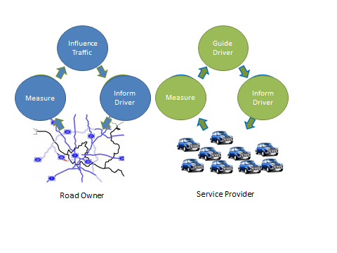
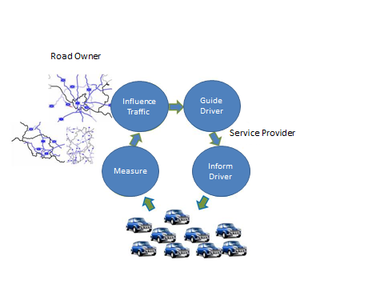
Traffic Management 1.0
Principles of Traffic Management 2.0
Collaboration and trust
Alignment of information to drivers and consistency
Co-opetition: understanding among stakeholders on interests and needs
Road operators & service providers
Road Operator
Service Provider
Separate control loops
Integrated control loops
TRB 2023 Angelos Amditis
Notes:
Traffic Management 2.0
Traffic Management has, in the past 7 years, been facing a large transformation, mainly pushed by the improvement of existing infrastructure (such as smart traffic lights and connected cameras), gradual introduction of new generation vehicles with increased connectivity between each other and to the infrastructure (thanks to 5G and the new C-ITS messages that permit a Vehicle-2-vehicle communication in real time for coordinated manoeuvres, for example for changing lanes), and by the development of new technological systems and procedures to better manage traffic operations and to offer new types of passenger and freight services. The rise of connected and automated driving is pushing for an evolution of Traffic Management systems.
Traffic Management 2.0 (TM2.0), stands for a collaborative concept for Traffic Management and Control between public and private partners and between vehicles and infrastructure. It is both a governance concept and a technology-based scheme of data sharing among traffic stakeholders.
The concept of TM2.0 is the evolution of current Traffic Management practices, which have, until recently, been mainly based on loop detectors (that detect vehicles e.g. at a traffic light) and static traffic data used by Traffic Management centres. TM2.0 concept is based on integrated control loops, as TM2.0 builds upon the deployment of connected vehicles and travellers to achieve convergence of mobility services and Traffic Management, combining actions of the individual travellers into a collective mobility system. This way, TM2.0 connects the innovative developments in the vehicle and on the road while improving the value of the service and at the same creating new business opportunities. The aim of TM 2.0 is not to chose the win of the individual or the win of the collective. The aim is to bring a balance on the needs of all stakeholders (slide later) from the public and private sector and the User of course, into an equilibrium.

Slide 36

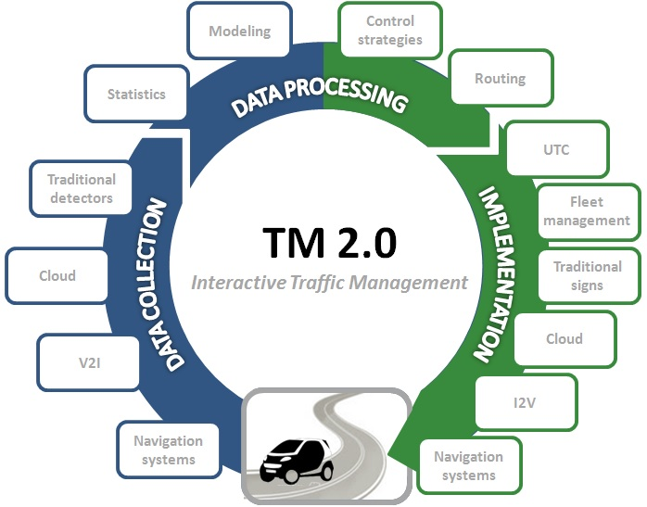
TM 2.0 – Data needs & Data feeds

Slide 37
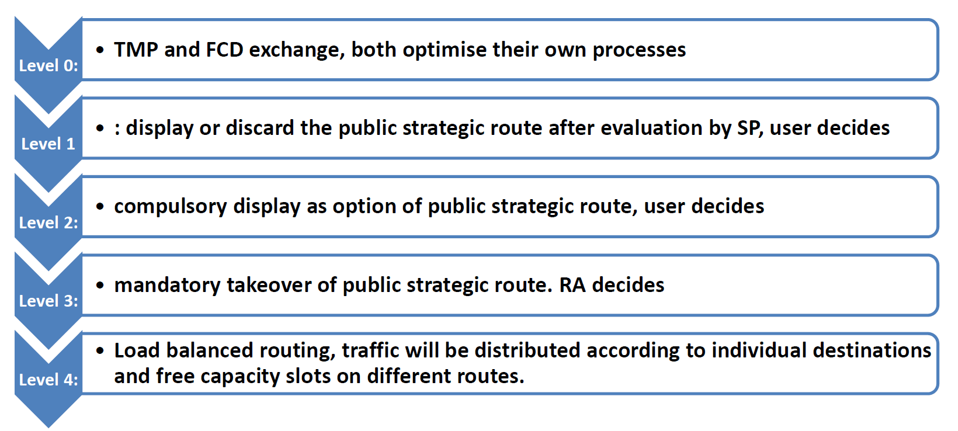
TM Cooperation levels between SPs and PAs in TM 2.0

Slide 38
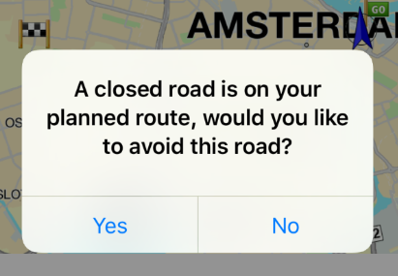
TM 2.0 –the concept
Routes according to TMPs are made available by the Nav. Service providers
Road closed in 30 mins due to prioritization of pedestrians (TMC preferred route).
Directly access many drivers and cars
Influence via Mobile Apps, In-Dash Navigation and PND’s
Routes automatically adjusted
Traffic data on highways and on secondary roads
TMC preferred route offered as an option to the driver

Slide 39
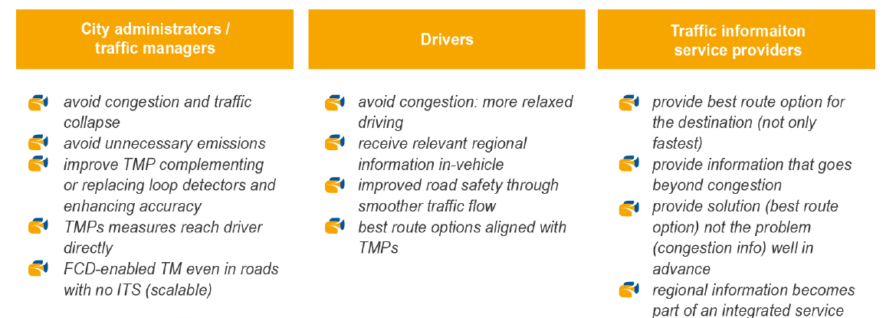
The TM 2.0 win-win-win

Slide 40

Interactive Traffic Management
Road Operator
Traffic Service provider
Mobility Operator
Travel Service provider
Traffic Management operator
Mobility integration platform
MaaS Operator
Principles:
Collaboration & Trust
Co-opetition
Loop of information in TM value-chain

Slide 41


Mobility Network Management
Road Operator
Traffic Service provider
Mobility Operator
Travel Service provider
MaaS Operator
Traffic Management operator
Mobility Integration platform
Principles:
Collaboration & Trust
Co-opetition
Loop of information in mobility value-chain

Slide 42

Innovation for
tomorrow’s journey.
J.Tzanidaki@mail.ertico.com

Slide 43
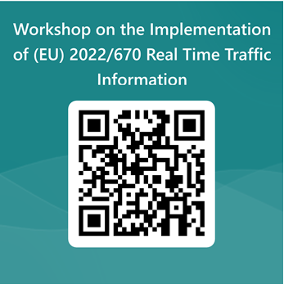
Serviceproviders perspective
Stephanie Leonard, TomTom

Slide 44
Wrap up and follow up

Slide 45
Follow up for now
TM2.0 meeting on February 22nd
Goal is to order the use cases on needed level of public-private cooperation so we can come to a roadmap.
Fysical meeting in Berlin hosted by TomTom end of April
Goal is to align on how we can get the use cases working.
Do you want to stay involved in this? Please send your contact details to:
    Stephanie.Leonard@TomTom.com
    Annet.van.Veenendaal@NDW.nu

